Slide 1


Ford 360° Exterior Lighting System
Team Members
Nam Cuong
Jordan Miller
Akshay Shankar
Liaison
Simon Curwood (Ford)

Slide 2
Table of Contents
Project Description
Architecture
LIN Sub-network
CAN Sub-network
Cellular Sub-network
Demonstration
Results

Slide 3
Project Description
The project was to construct an exterior lighting system prototype for a Ford truck.
This lighting system is required to,
Illuminate the surroundings of the truck to perform outdoor activities at night like camping, tailgating, working etc.
Illuminate the vehicle to be able to seen from distance when required
Able to be controlled using a cell phone through a cellular network
Completely powered of a 12 V car battery
Utilize communication protocols that are current standards in the automotive industry

Slide 4
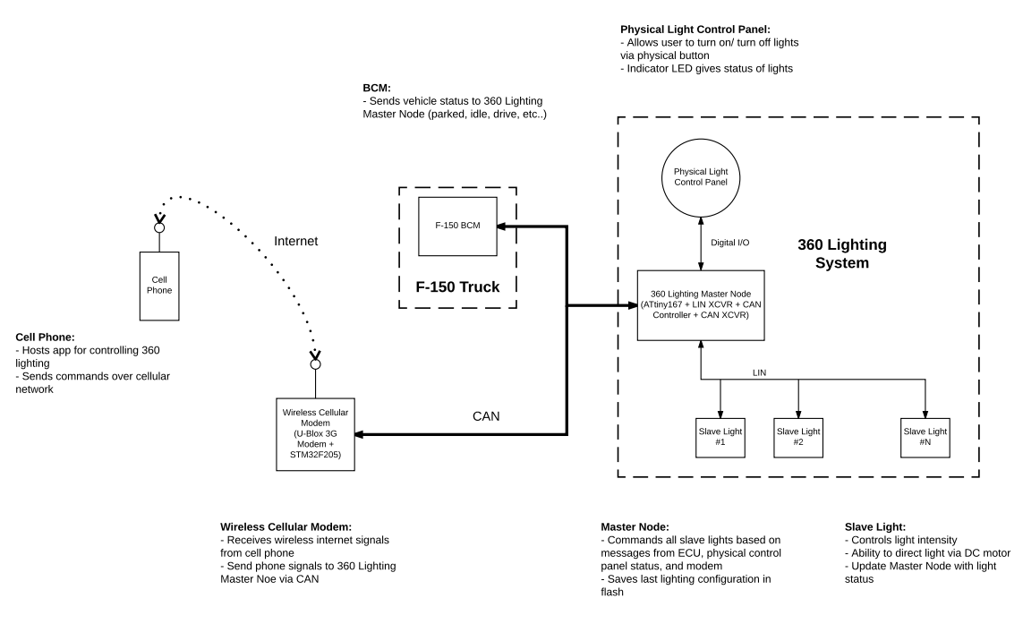
Architecture

Slide 5
LIN (Local Interconnect) Sub-network
The LIN protocol was used between the master node and multiple slave node to communicate with a each other
LIN was chosen as it is a cheap, single wire communication standard and is commonly used for vehicle subsystems where the range and speed of CAN are not required
The LIN sub-network consists of 9 nodes (max 16) that talk to a single master node
Master node utilizes a Atmel ATTiny167
Slave nodes utilize custom made PCBs that are mounted on the test frame along with a servo and LED module
7 x 180° servos (TowerPro MG995), 2 x 360 ° servos (Joysway Sail Servos)
9 Light Modules (Cree X-ML, capable of 100 lumens)

Slide 6
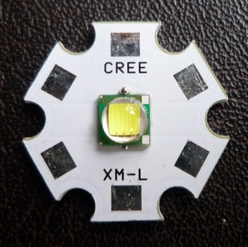
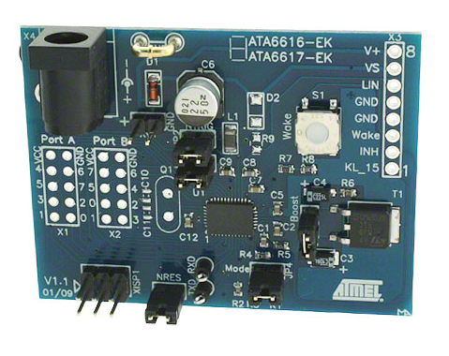
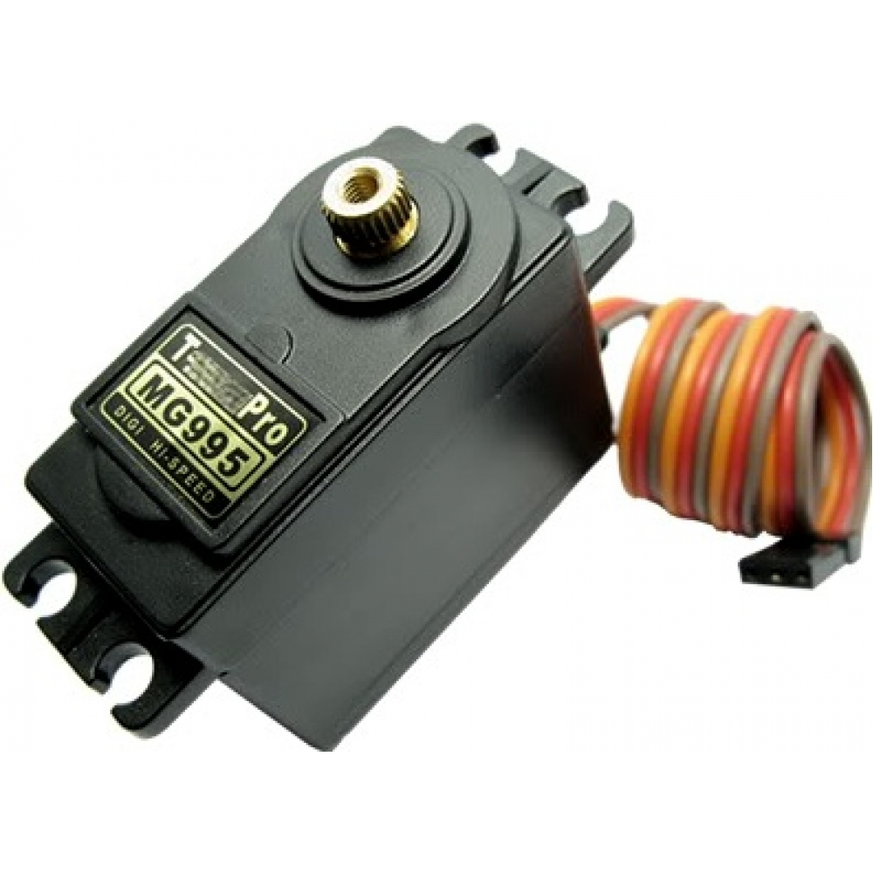
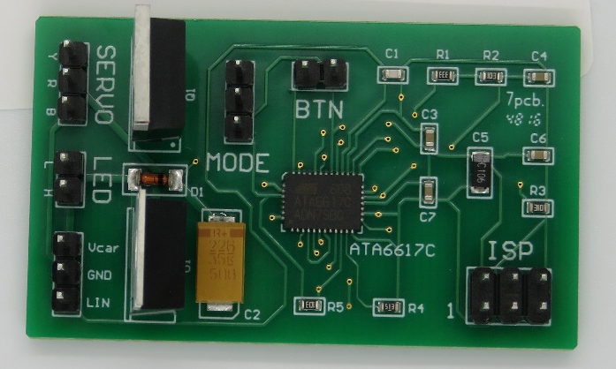
LIN Components
TowerPro MG995
ATA6617 w/ ATTiny167
Cree XML
Custom Slave PCB

Slide 7
CAN (Controller Area) Sub-network
The CAN communication protocol is used to talk between the cellular modem and the master node of the LIN sub-network
CAN was chosen as it is reliable over long distances, gives a larger diversity over the range of messages it can identify and process and is the standard for modern vehicle communication.
To reduce CAN overhead, we talk to a MCP25625 CAN controller through the ATTiny 167 Master Node via SPI (Serial Peripheral Interface)
The CAN Controller independently handles the transmit, receive and error detection for each CAN message and notifies the ATTiny 167 master node accordingly.

Slide 8
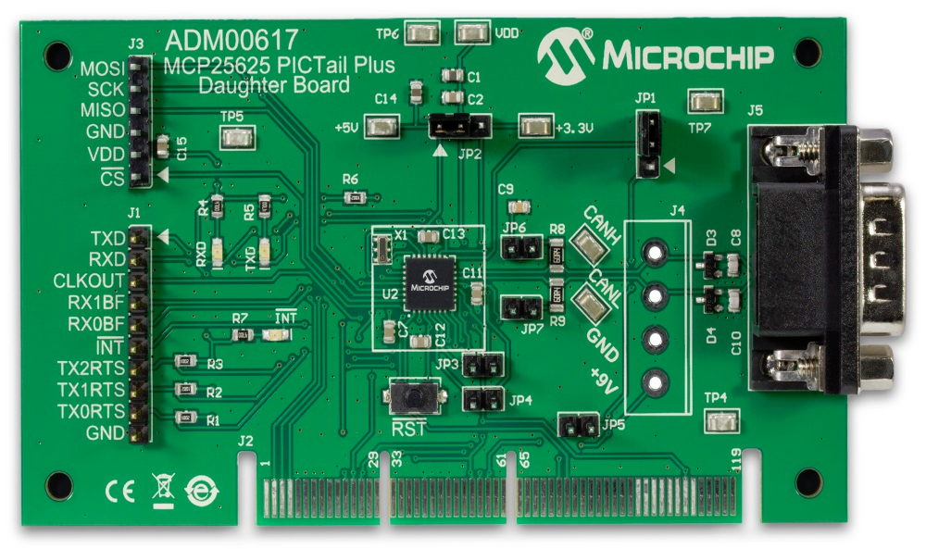
CAN Components
ADM00617 w/ MCP 25625 CAN Controller
ATA6617 w/ ATTiny167

Slide 9
Cellular Sub-network

Slide 10
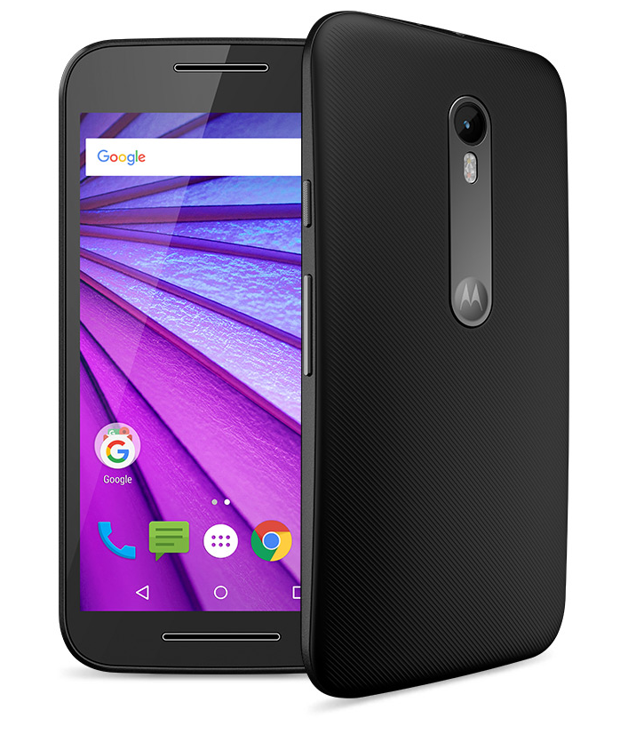
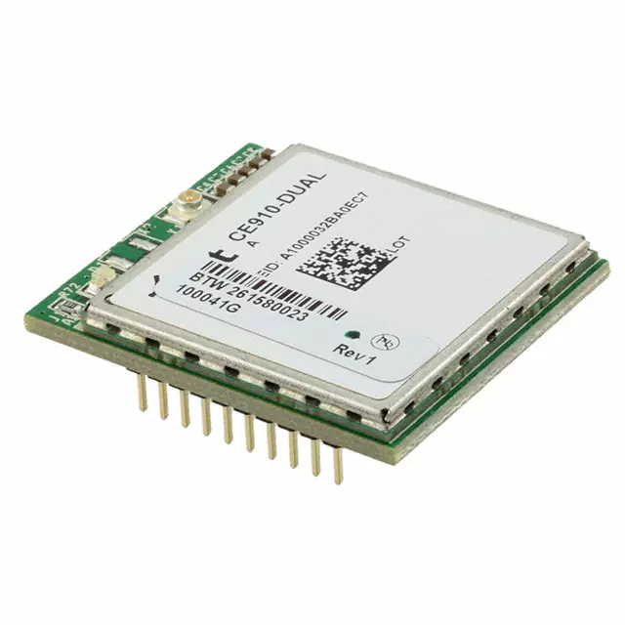
Cellular Components
NimbeLink
NL-SW-LTE-GELS3-B
ATA6617 w/ ATTiny167
Motorola G3

Slide 11
Demonstration

